Slide 1
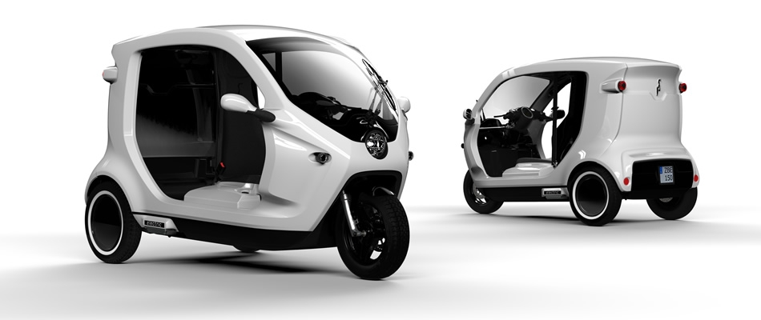
DESIGN OF DOWNSIZED HYBRID POWERTRAIN FOR THREE-WHEELER VEHICLE
Presented by
Igbomezie Michael Dubem
U2013/3025005
SUPERVISOR: Dr. M. M. Ojapah

Slide 2
OUTLINE
Introduction
Problems statement
Aim and Objective
Scope & Limitations
Literature Review
Geometric Hybridization
Analytical Hybridization
Powertrain Downsizing and Model Optimization
Conclusion
Recommendation

Slide 3
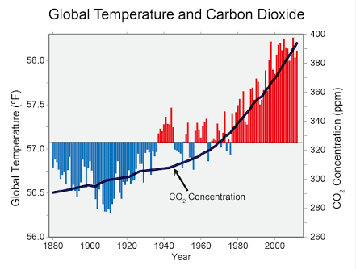
Introduction
(Source:www.epa.gov)
In recent times, there has been a global awareness of increased
carbon footprint caused by continuous use of fossil fuel
for vehicle propulsion.

Slide 4
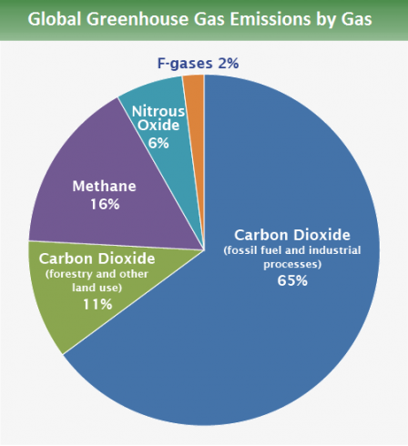
CO₂ is a major contributor to
these green house gases. If these
rates are left unchecked, they begin
to pose serious problems.
Rise of Ocean levels and flooding
Change in climate, which in turn
will affect all its dependent systems.
This is just to mention a few.
(Source:www.epa.gov)

Slide 5
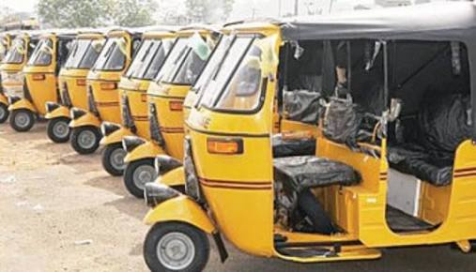
Problem statement
The Auto-Rickshaw is a major means of transportation in Nigerian, and as such is a major contributor of carbon emission in the country.
Despite just being a major source of carbon emission, the daily cost of operation, which is largely dependent on the price of fuel is high.

Slide 6
Aim and objectives
The aim of this project is to downsize and hybridize the powertrain of the three-wheeler which is fast becoming the common means of commercial transportation in rural, sub-urban and urban areas. The hybridization and downsizing of the three-wheeler will reduce the amount of carbon emission and create a greener friendly environment, as well as reduce the overall cost of maintenance and operation.

Slide 7
Scope & limitations
This project is limited to the series hybridization of the Auto Rickshaw.
All values and procedures contained in this project is peculiar to the Piaggio Ape City Auto-Rickshaw.
The result of the research that led to the commencement of this project was obtained using Port Harcourt City as the case study.
The virtual hybridization process was carried out using the Matlab & Simulink and Solidworks Computer Program, so it’s results are largely dependent on these software used.

Slide 8
Literature review
EARLY DEVELOPMENT
The concept of hybridization of vehicles date back to the late 1800s.
The first hybrid vehicle was invented by a young Austrian engineer named Ferdinand Porsche and Jacob Lohner in 1898.
It was the brainchild of Jacob Lohner. In 1896, Ferdinand Porsche invented the electric wheel-hub motor, a battery-operated motor that fits inside the hub of a wheel. The in-wheel motors were combined with one of Jacob Lohners coaches and the result was the Lohner-Porsche Elektromobil.
In 1900 at the World’s fair in Paris the ‘System Lohner-Porsche’ was debuted. The Lohner-Porsche Elektromobil could achieve a top speed of 61.2 kilometers per hour, a speed record set in Austria.

Slide 9
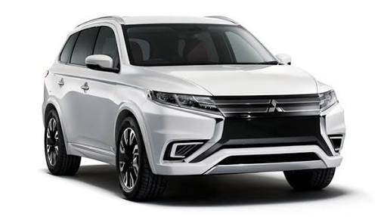
Literature review
RECENT DEVELOPMENTS:
The first generation Toyota hybrid system consisted of two models, the NHW10 and NHW11. The mileage for the first generation Prius was 5.7L/100km.
The second generation used the Hybrid Synergy Drive. The mileage for the second generation Prius was 5.1L/100km.
The third generation improved the hybrid synergy drive even further. It has a significant reduction in weight and size, contributing to the overall improvements in fuel economy.

Slide 10
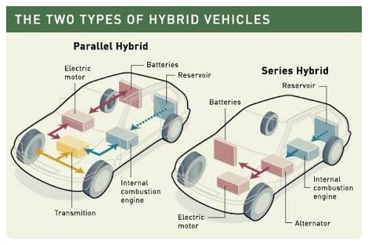
Types of hybrid

Slide 11
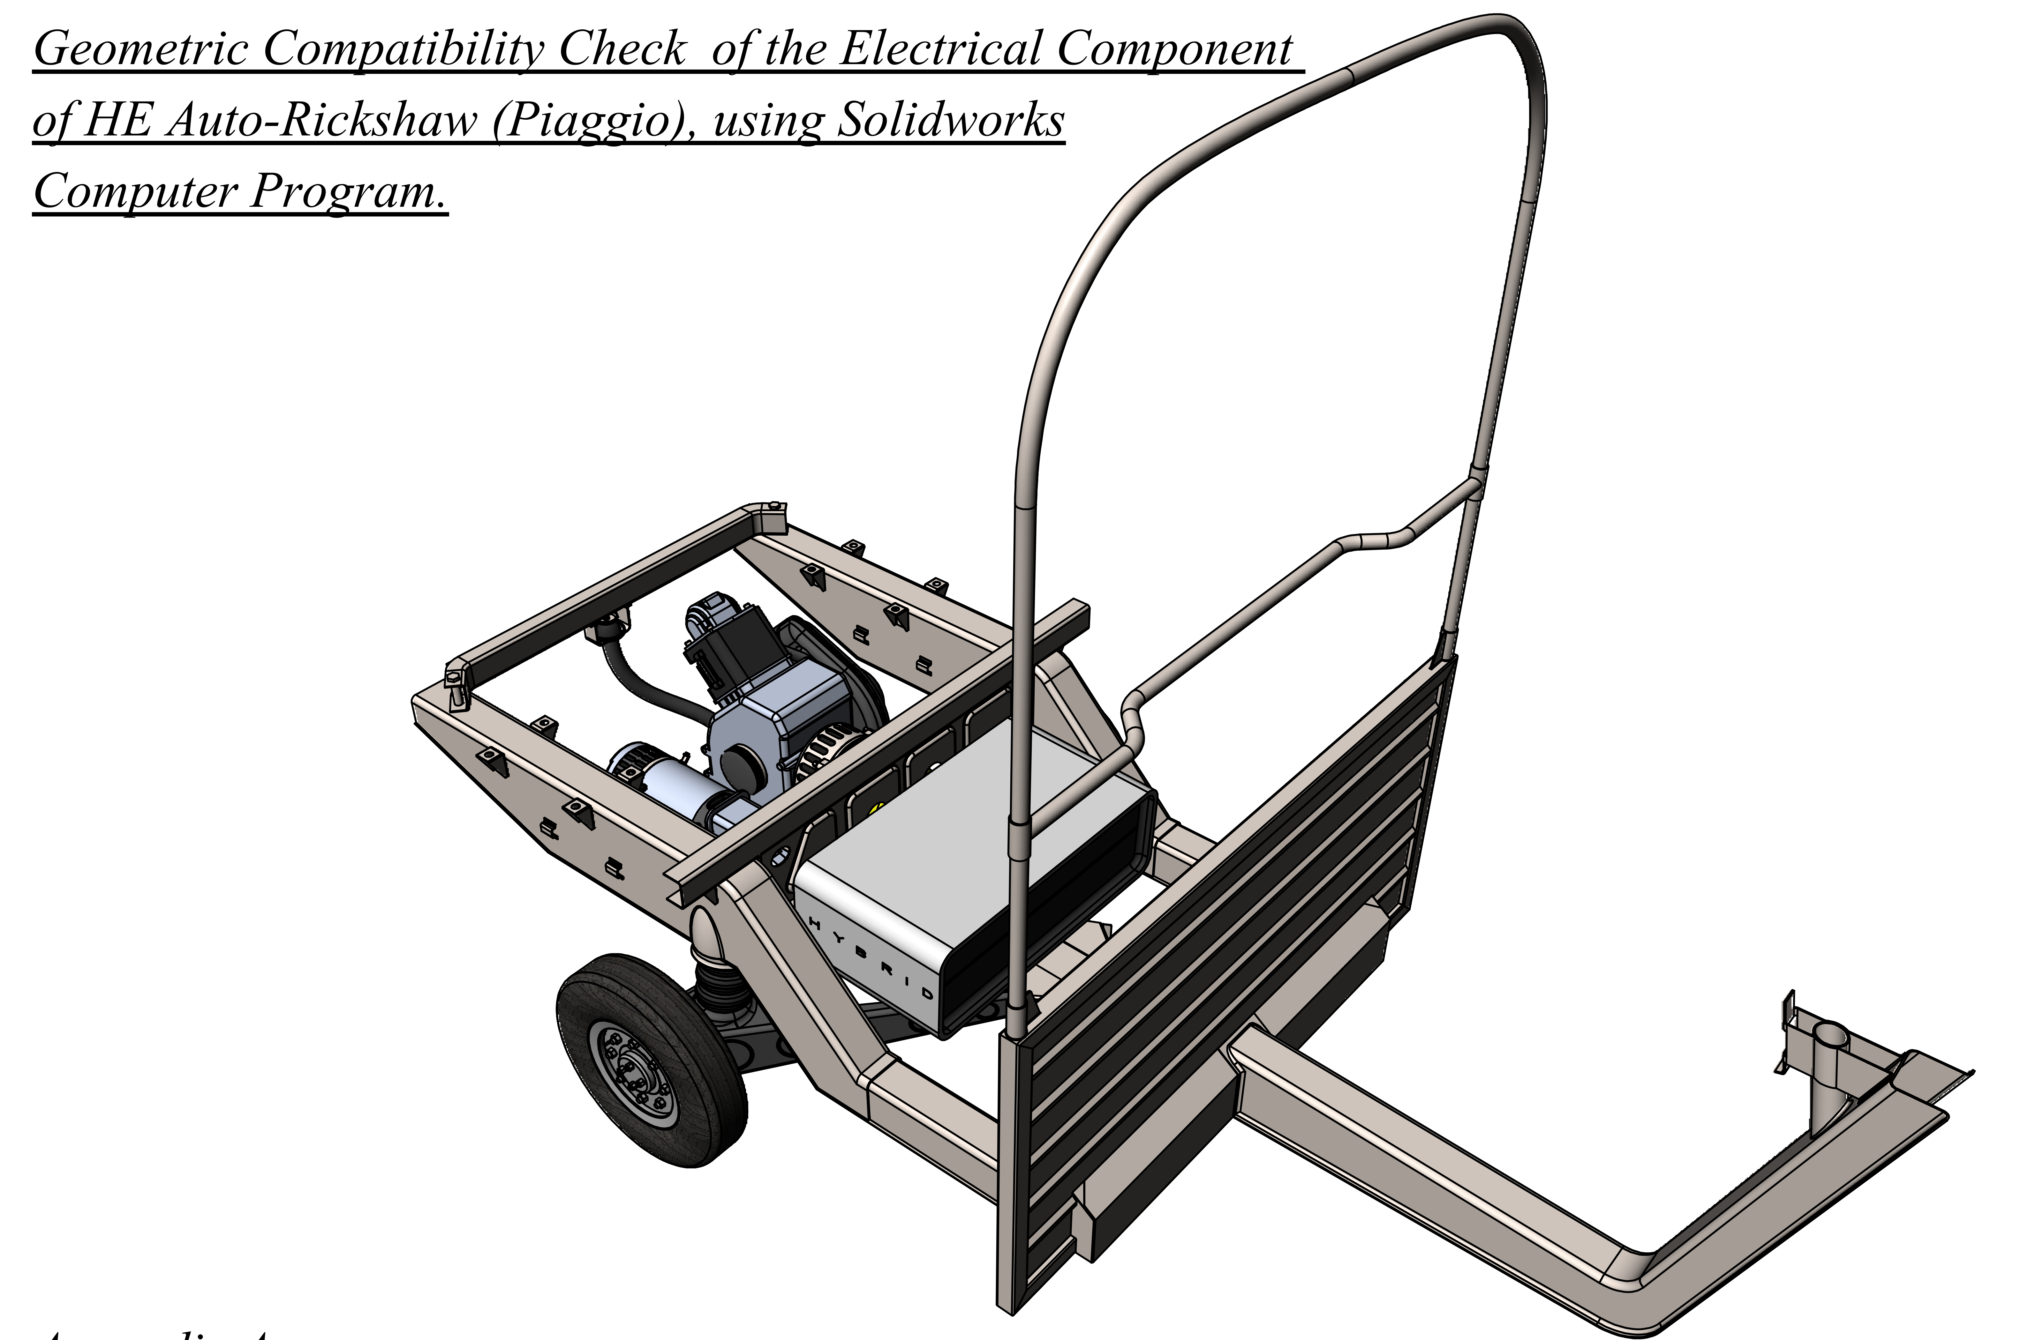
Geometrical Hybridization

Slide 12
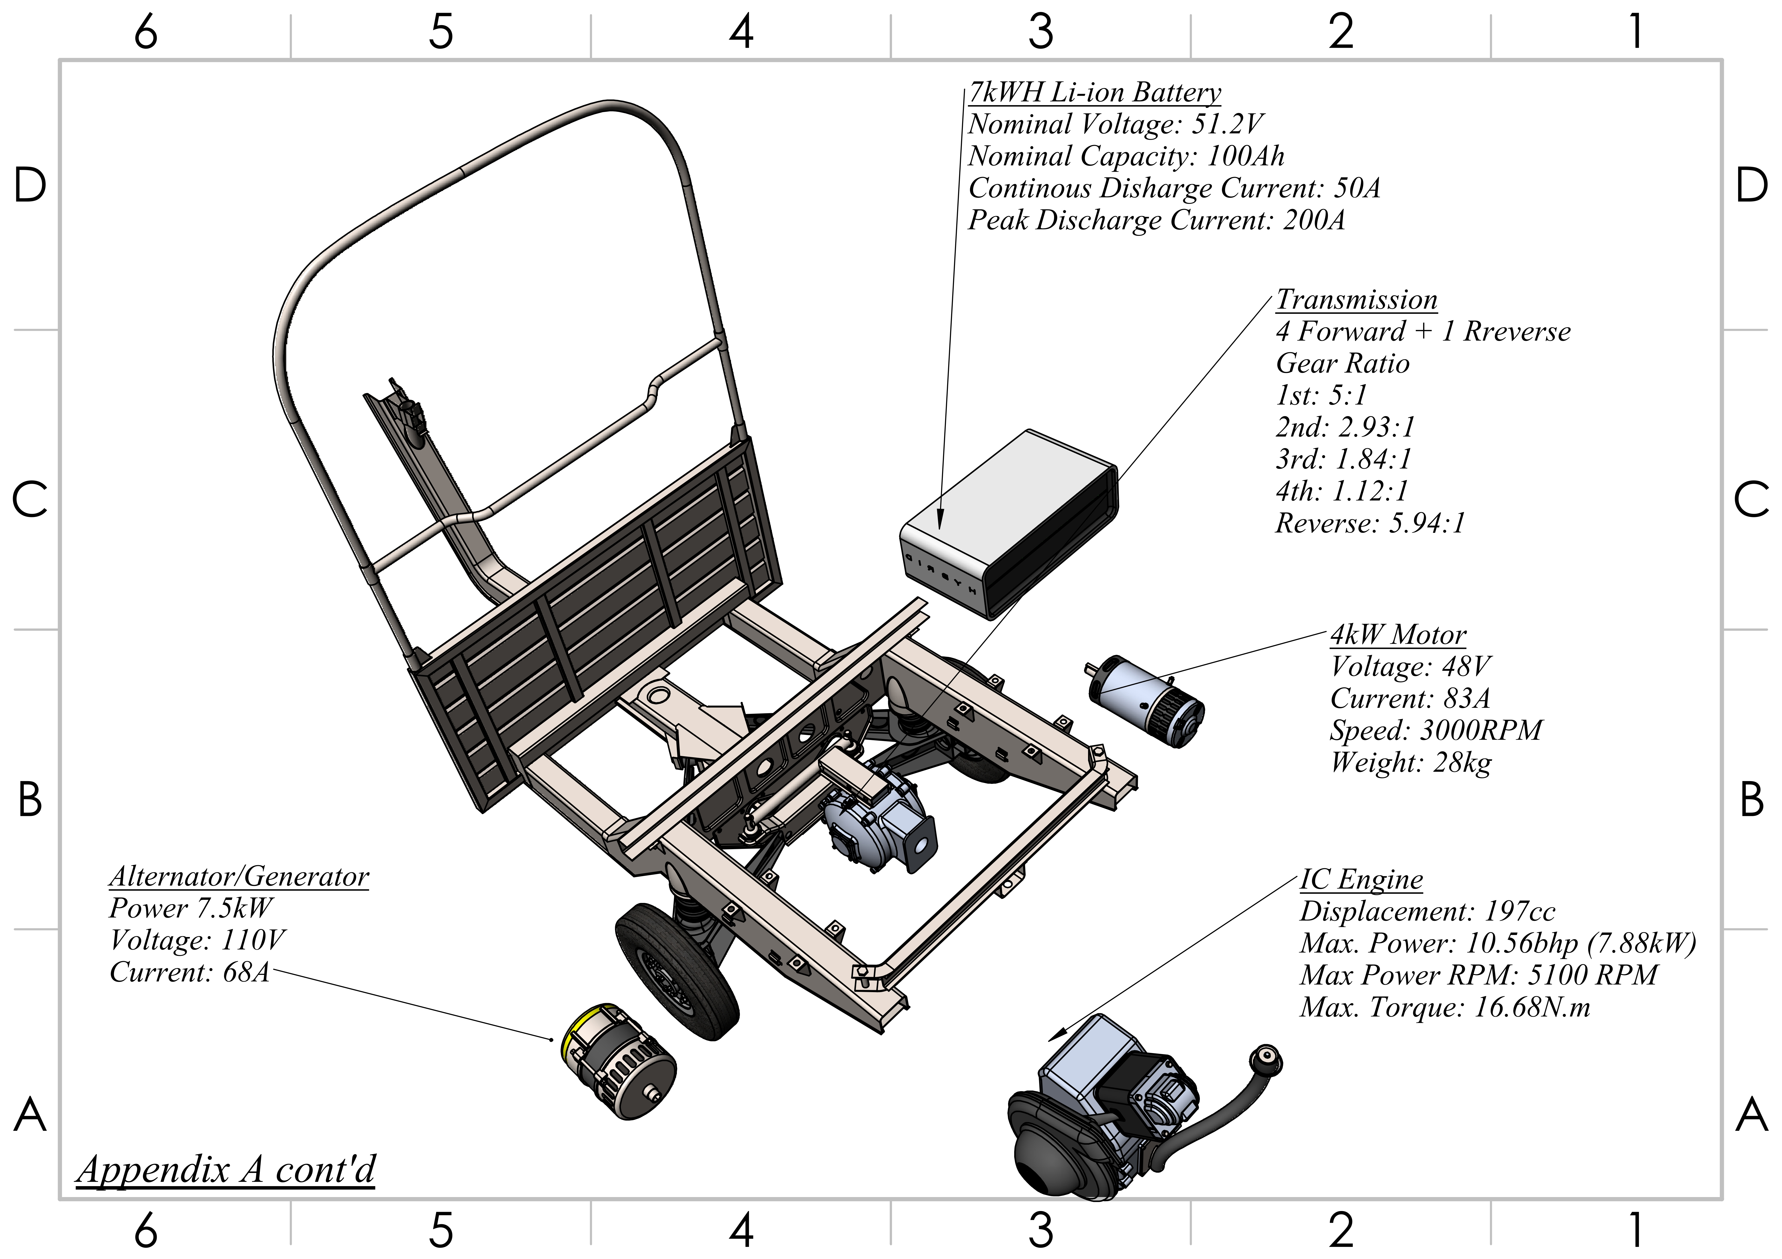
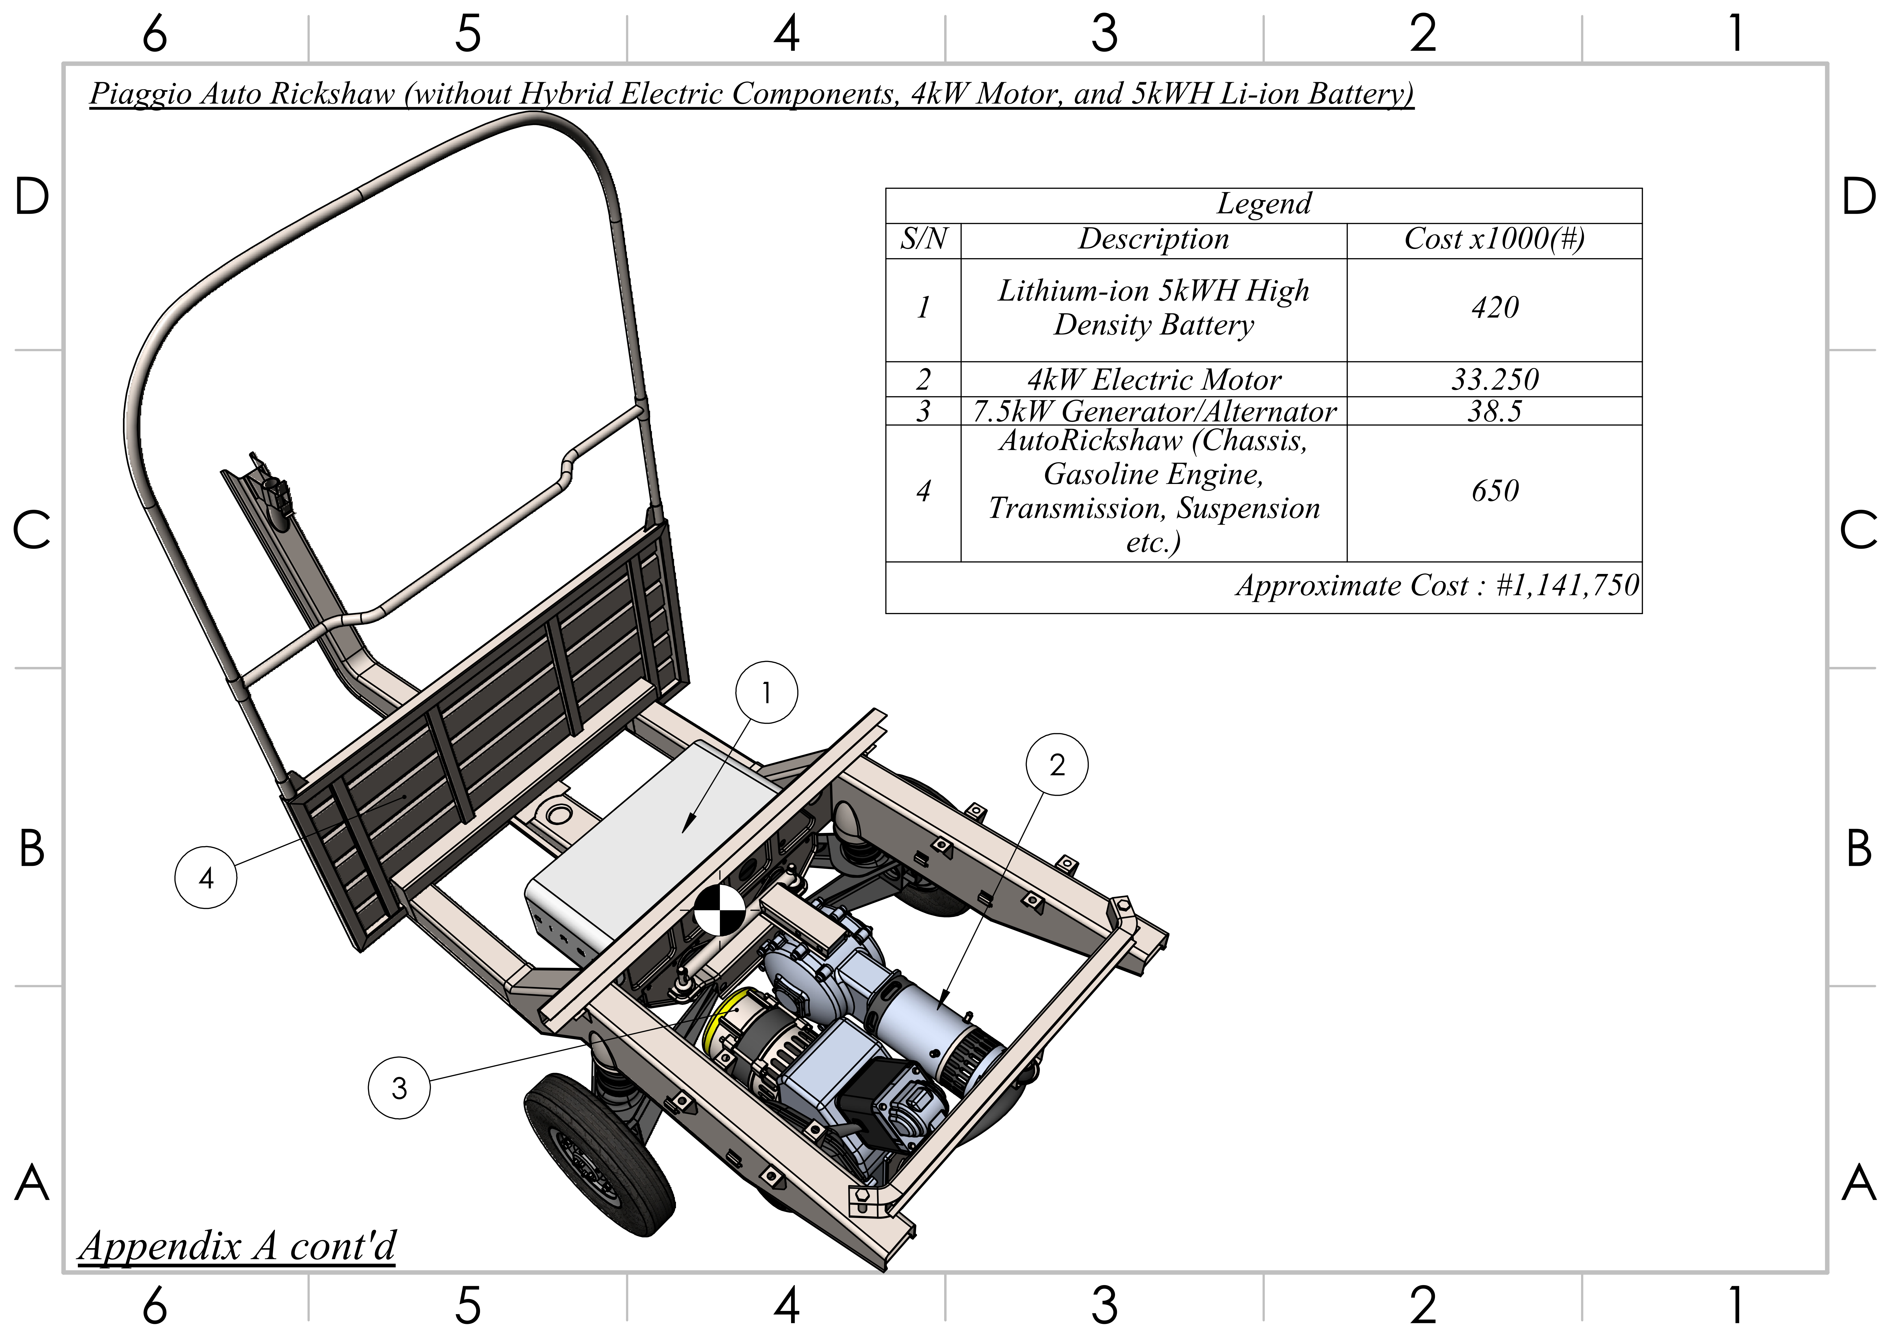
Exploded View of Hybrid Model

Slide 13
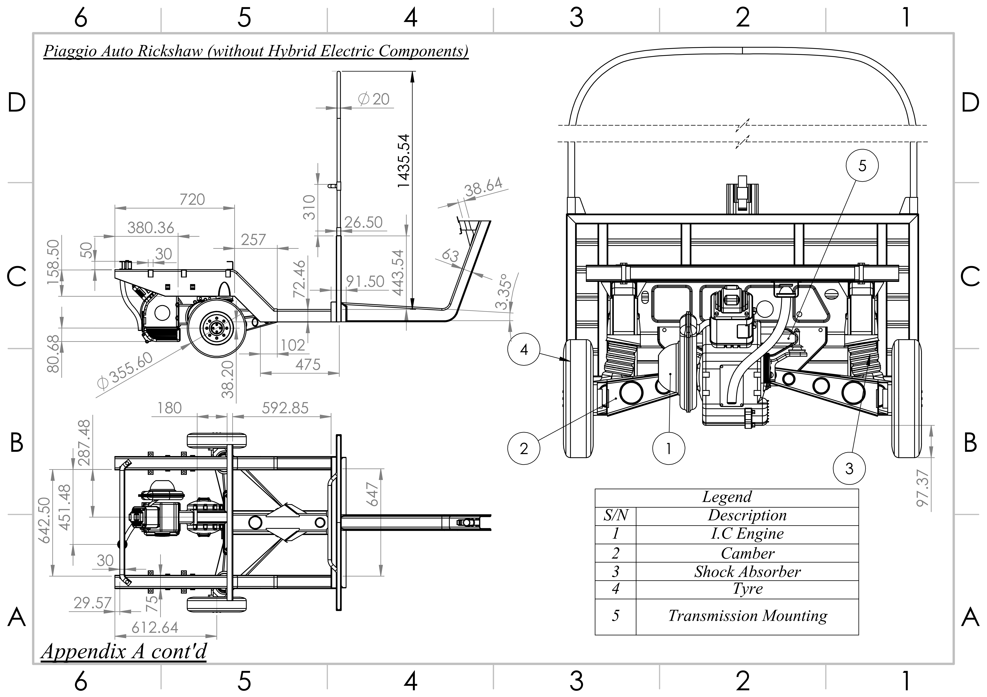
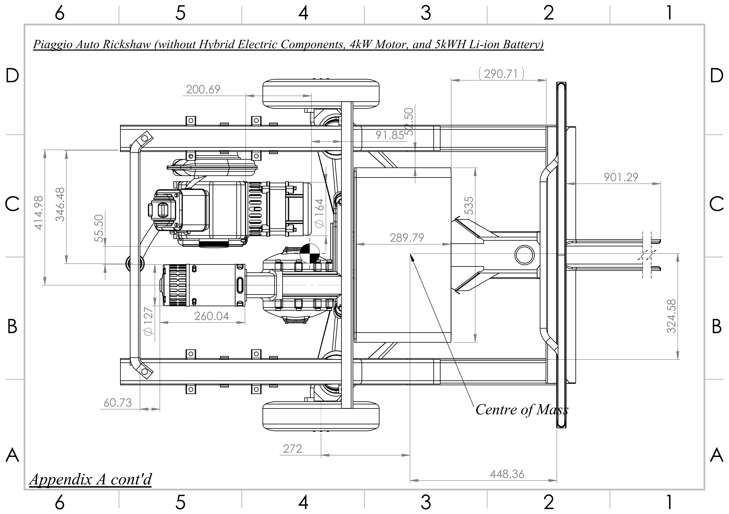
Dimensions of the Three Wheeler

Slide 14
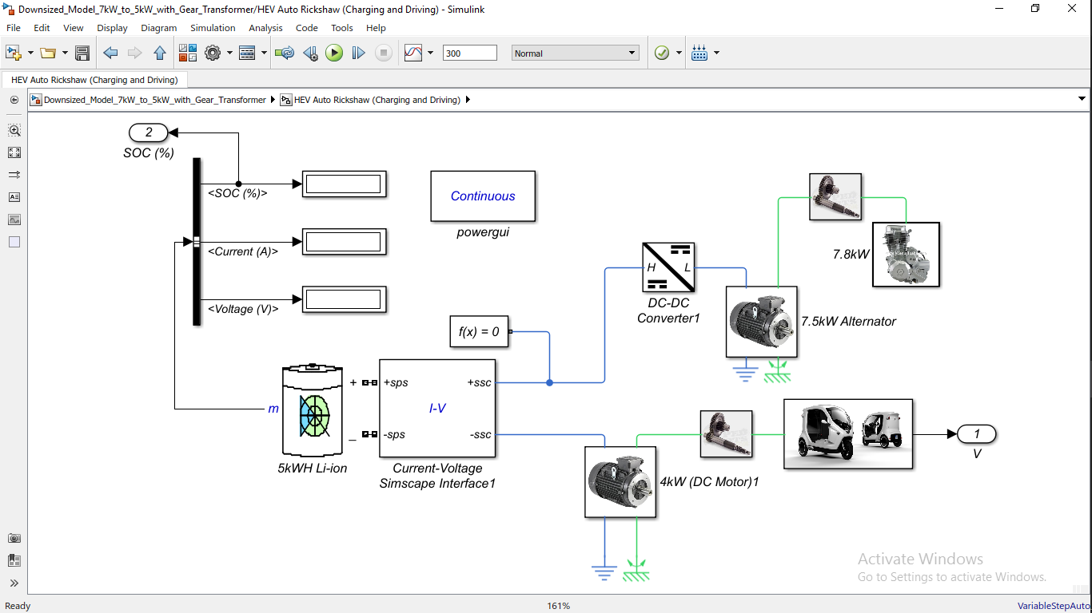
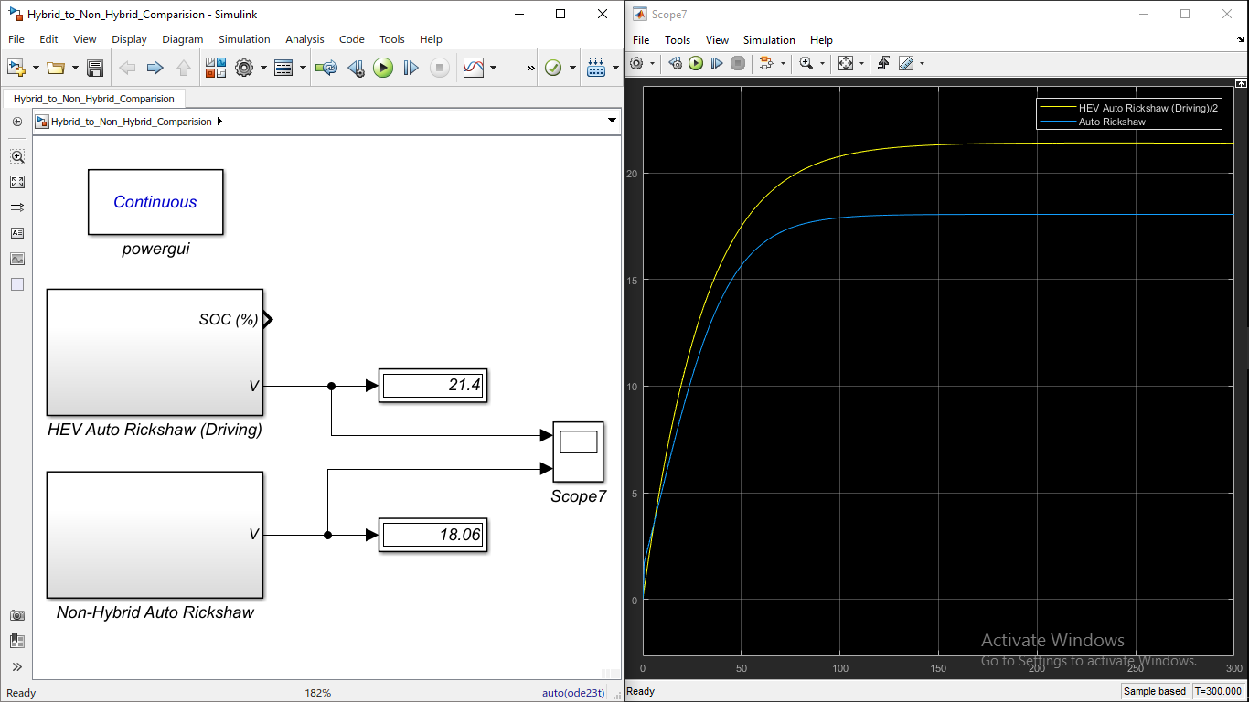
Analytical Hybridization

Slide 15
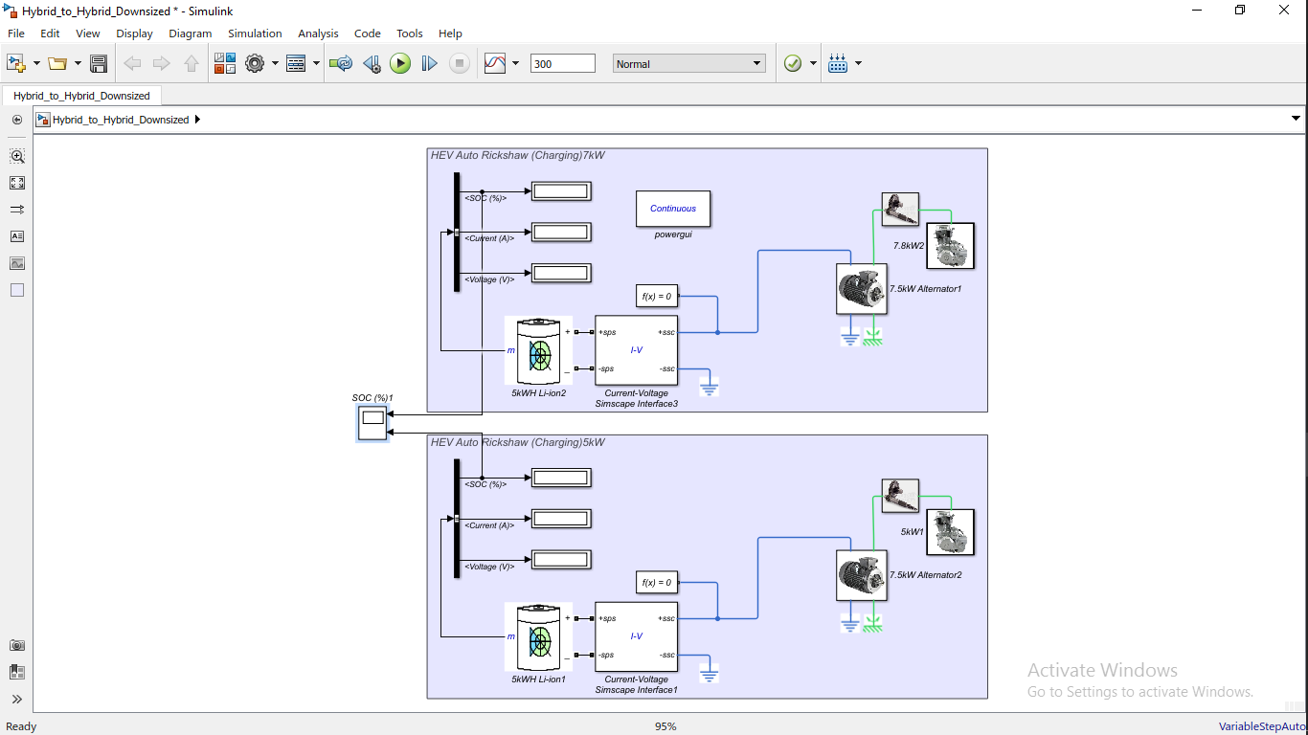
Powertrain Downsizing

Slide 16
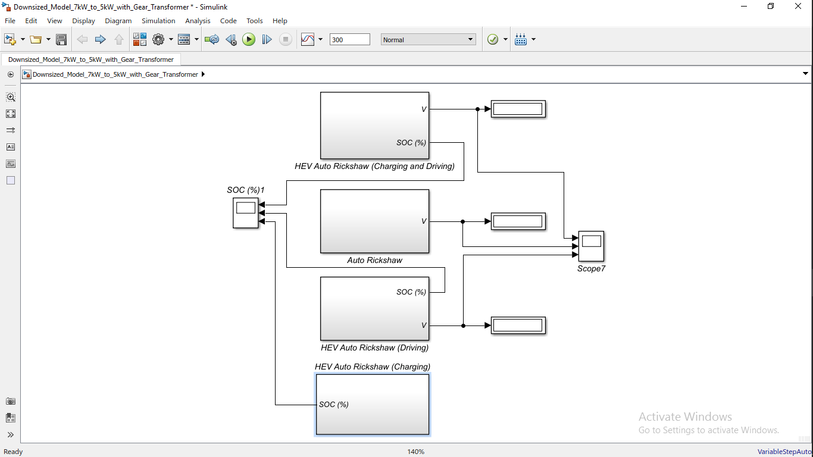
Model Optimization

Slide 17
Conclusion
In a world of depleting fossil fuel and increasing rate of global warming, Hybrid Electric vehicle seem like one solution that requires attention.
Due to the fact that Auto-Rickshaws are a major part of the transport system in Nigeria, it became a good place to start.
The entire project involved the electrical hybridization of the Three-wheeler (Auto-Rickshaw) and downsizing of the powertrain to reduce its fuel consumption and CO₂ emission rate.
With the help of Matlab & Simulink and Solidworks Computer Program, some percentage drop of about 30% was attained with the modeled hybrid systems as compared to the regular Auto-Rickshaw.

Slide 18
Recommendation
For further Research
Regenerative Braking
Parallel and Series-parallel Hybrid
Power transformer
Aerodynamically Favourable Vehicle Surface
Weight Reduction
Turbochargers

Slide 19


